Slide 1
Data Science New Field … No Textbook
Machine Learning
Efficient Reusable Code:
You use C/C++ or Java
Data Visualization:
You use D3js

Slide 2
A Word On OS’s
Most data scientists use OSX / Linux.
ALL data scientists need to be fluent with UNIX command line. Programs to know:
scp -- (secure copy) move files between computers
ssh -- (secure shell) work on a remote computer
vim (or pico or emacs) -- a text editor

Slide 3
If You Are Coming From Statistics Side…
Take the time to learn a statically typed language (C++ or Java/Scala) and really think about data structures and when/why they are used.
Arrays (python -- numpy)
Linked lists (python -- list)
Hashing (python – set & dict )
Learn about object oriented design
Learn to use GIT

Slide 4
If You Are Coming From CS Side
Think critically about your data. Model preforms really well? You probably did something wrong.
Scikit learn API is a very dangerous thing.
Data science is a science and not product. Not all questions are answerable. Agile methods generally don’t apply.
The metric “Accuracy” is the root of all evil. Get serious, never use it.

Slide 5
I Highly Recommend:
Try implementing your own Machine Learning algorithms.
“What I cannot create I do not understand”
Obviously don’t use your own implementation for any practical work.

Slide 6
Tools Everyone Needs:
Ipython terminal
A text editor. Pick one and master it.
SQL
GIT
A good visualization library. Pick one and master it.

Slide 7
Think Like A Scientists!!!!

Slide 8
Some Made Up But True Statistics About Machine Learning

Slide 9
More Made Up But True Statistics About Machine Learning

Slide 10
Central Theory of Supervised Machine Learning
Some Matrices of Features X
Some Function of X:
h(X)
Some Target Values Y
Size (ft²) | Style | …. | Neighborhood | Year Built
1,200 | Spanish |  | Oak Forrest | 1974
4,000 | Tudor |  | Park Glenn | 1953
2,600 | Rach |  | Deer Run | 1995
3,600 | Modern |  | Oak Forrest | 1973
1,800 | Spanish |  | Ridgewood | 2001
Market Value
$120,000
$350,000
$225,000
$530,000
$183,000

Slide 11
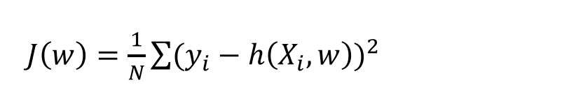
ML IS The Minimization of A Cost Functions
Hypothesize:
Target Value Y
h(X,w) = w₁*x + w₀
Some Feature X

Slide 12
What Features Would You Use To Classify?
Shape 1
Shape 2
Shape 3
Shape 4
Shape 5

Slide 13
What Features Would You Use To Classify?
Positive Review
Negative Review
April 2, 2017 8:43 AM EST: USER 14325.
I have bought several of the Vitality canned dog food products and have found them all to be of good quality. The product looks more like a stew than a processed meat and it smells better. My Labrador is finicky and she appreciates this product better than most.
June 5, 2014 12:43 PM PST: USER 8530.
Product arrived labeled as Jumbo Salted Peanuts...the peanuts were actually small sized unsalted. Not sure if this was an error or if the vendor intended to represent the product as "Jumbo".

Slide 14
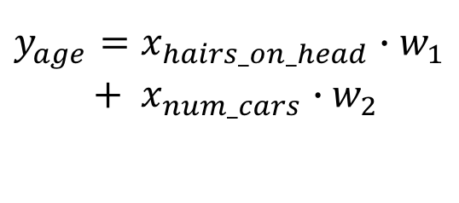
Real Numbers: Feature Scaling
In [4]: df = pd.DataFrame(data={’Age':[28,17,43,85,19],
'Hairs':[94e3,121e3,87e3,63e3,154e3],
'Cars':[1,0,2,0,1]})
In [5]: df.head()
Out[5]:
Cars Hairs Age
0 1 94000.0 28
1 0 121000.0 17
2 2 87000.0 43
3 0 63000.0 85
4 1 154000.0 19
In [6]: SS = preprocessing.StandardScaler(
with_mean=True, with_std=True)
In [7]: df[['Hairs','Cars']]=SS.fit_transform( df[['Hairs','Cars']])
In [8]: df.head()
Out[8]:
Age Cars Hairs
0 28 0.267261 -0.314374
1 17 -1.069045 0.551758
2 43 1.603567 -0.538927
3 85 -1.069045 -1.308822
4 19 0.267261 1.610365
Age | Hairs On Head | Cars
28 | 94,000 | 1
17 | 121,000 | 0
43 | 87,000 | 2
85 | 63,000 | 0
19 | 154,000 | 1

Slide 15
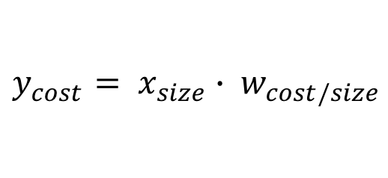
Categorical Data (Ordinal)
In [1]: import sklearn
In [2]: from sklearn import preprocessing
In [3]: import pandas as pd
In [4]: shirts =pd.DataFrame(data=
{'Size':['Large','Small', 'Medium', 'Large', ‘Small']})
In [5]: shirts.head()
Out[5]:
Size
0 Large
1 Small
2 Medium
3 Large
4 Small
In [6]: le = preprocessing.LabelEncoder()
In [7]: le.fit_transform(shirts.Size)
Out[7]: array([0, 2, 1, 0, 2])
Small
Medium
Large
Cost
Size

Slide 16
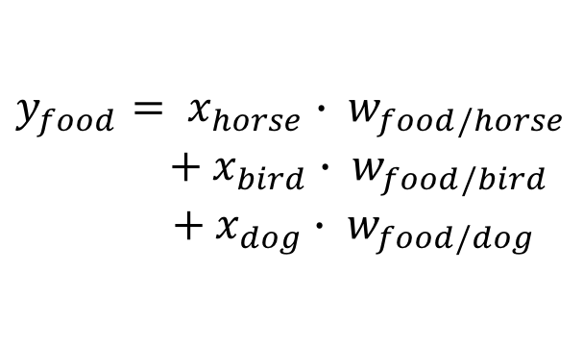
Categorical Data (Non-Ordinal)
In [1]: import sklearn
In [2]: from sklearn import preprocessing
In [3]: import pandas as pd
In [4]: animal = pd.DataFrame(data={'Animal':['Dog','Horse', 'Bird', 'Dog', 'Horse']})
In [5]: animal.head()
Out[5]:
Animal
0 Dog
1 Horse
2 Bird
3 Dog
4 Horse
In [6]: ohe=preprocessing.OneHotEncode()
In [7]: ohe.fit_transform(animal.Animal)
Out[7]:
array([[0, 1, 0],
[0, 0, 1],
[1, 0, 0],
[0, 1, 0],
[0, 0, 1]])
Horse
Bird
Dog
Food
?
Animal

Slide 17
Imputation
In [4]: df = pd.DataFrame(data={’Age':[np.nan,17,43,85,19],'Hairs':[94e3,np.nan,87e3,np.nan,
...: 154e3],'Cars':[1,0,2,0,np.nan]})
In [4]: df.head()
Out[4]:
Age Cars Hairs
1 NaN 1.0 94000.0
2 17.0 0.0 NaN
3 43.0 2.0 87000.0
4 85.0 0.0 NaN
5 19.0 NaN 154000.0
In [5]: freq_impute = preprocessing.Imputer(
strategy='most_frequent')
In [6]: freq_impute.fit_transform(df)
Out[6]:
array([[ 1.7e+01, 0.0e+00, 8.7e+04],
[ 4.3e+01, 2.0e+00, 8.7e+04],
[ 8.5e+01, 0.0e+00, 8.7e+04],
[ 1.9e+01, 0.0e+00, 1.5e+05]])
In [48]: mean_impute = preprocessing.Imputer(strategy='mean')
In [50]: mean_impute.fit_transform(df)
Out[50]:
array([[ 1.7e+01, 0.0e+00, 1.2e+05],
[ 4.3e+01, 2.0e+00, 8.7e+04],
[ 8.5e+01, 0.0e+00, 1.2e+05],
[ 1.9e+01, 6.7e-01, 1.5e+05]])
df.dropna()
Age | Hairs On Head | Cars
43 | 87,000 | 2
Age | Hairs On Head | Cars
NaN | 94,000 | 1
17 | NaN | 0
43 | 87,000 | 2
85 | NaN | 0
19 | 154,000 | NaN
df.dropna(subset=‘Age’)
Age | Hairs On Head | Cars
17 | NaN | 0
43 | 87,000 | 2
85 | NaN | 0
19 | 154,000 | NaN

Slide 18
Polynomial Features
In [4]: df = pd.DataFrame(data={'x':range(0,6)})
In [5]: df.head()
Out[5]:
x
0 0
1 1
2 2
3 3
4 4
In [6]: pf =preprocessing.PolynomialFeatures( degree=3, interaction_only=False,
include_bias=False)
In [7]: pf.fit_transform(df)
Out[7]:
array([[ 0., 0., 0.],
[ 1., 1., 1.],
[ 2., 4., 8.],
[ 3., 9., 27.],
[ 4., 16., 64.],
[ 5., 25., 125.]])
Y = w₁*x + w₂*x²
Y = w₁*x + w₂*x² + w₃*x³
Y = w1*x

Slide 19
Even More Made Up But True Statistics About Machine Learning

Slide 20
Overview of Sklearn API: Create The Model
from sklearn import linear_model
Your Model
Your Hyperparameters
rc = linear_model.RidgeClassifier( alpha=1.0,
fit_intercept=True,
normalize=False,
copy_X=True,
max_iter=None,
tol=0.001,
class_weight=None,
solver=’auto',
random_state=None)

Slide 21
Overview of Sklearn API: Train the Model to Find Optimal Paramaters
rc = linear_model.RidgeClassifier(…….)
Your Model
Your features
Your Answers
rc.fit( X_training_features, y_training_answers )
Predicted output
Your testing features
predictions = rc.predict( X_test_features )

Slide 22
Overview of Sklearn API: Evaluate The Model
rc = linear_model.RidgeClassifier(…….)
rc.fit( X_training_features, y_training_answers )
predictions = rc.predict( X_test_features )
Now do it again with different hyperparameters!!!!

Slide 23
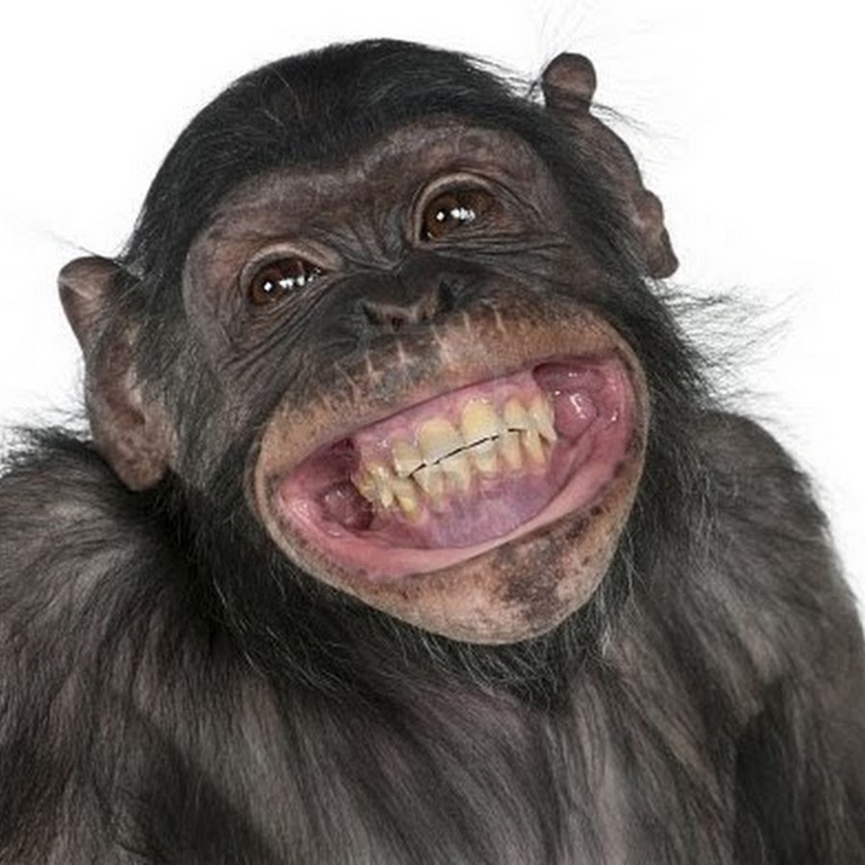
I Plug Things Into sklearn!

Slide 24
The Basics: ML Algorithms to know
Cross Validation
LOGISTIC REGRESSION
K-Nearest Neighbors
Random Forrest
K-Means Clustering

